Slide 1
Platforms: Lecture 8: Peripherals

Slide 2
What is a peripheral?
Devices that are separate from the basic computer
Not the CPU, memory, power supply
Classified as input, output, and storage
Connect via
Ports: parallel, USB1.0 (1.5Mb/s), USB1.1 (12 Mb/s), USB2.0 (480Mb/s), USB3.0 (4 Gb/s), serial
Interface to systems busses: SCSI (Small Computer Systems Interface), IDE (Integrated Drive Electronics, WD) - ATA, ATAPI; PATA, SATA, PCMCIA (Personal Computer Memory Card International Association)
Many slides using pictures from Englander (2003) and Silberschatz (2005)

Slide 3
Storage Devices
Primary memory
Data and programs must be copied to primary memory for CPU access
Secondary storage
Permanence of data
Direct access storage devices (DASDs)
Online storage
Offline storage – loaded when needed
Speed
Measured by access time and data transfer rate
Access time: average time it takes a computer to locate data and read it
Data transfer rate: amount of data that moves per second

Slide 4
Hierarchy of Storage

Slide 5
Secondary Storage Devices
Hard drives, floppy drives
CD-ROM and DVD-ROM drives
CD-R, CD-RW, DVD-RAM, DVD-RW
Tape drives
Network drives
Direct access vs. Sequential access
Rotation vs. Linear

Slide 6
Magnetic Disks 1
Magnetic disks provide bulk of secondary storage of modern computers
Disks can be removable
Drive attached to computer via I/O bus
Busses vary, including EIDE, ATA, SATA, USB, Fibre Channel, SCSI
Host controller in computer uses bus to talk to disk controller built into drive or storage array
Notes:
SCSI – Small Computer Systems Interface
IDE (Integrated Drive Electronics, WD) – ATA, ATAPI; PATA, SATA
PCMCIA - Personal Computer Memory Card International Association
EIDE – Enhanced IDE
eSATA – External SATA
ISA – Industry Standard Architecture from XT 8 bit, 16 bit AT, no mix
PCI – Peripheral Component Interface, 32/64 bit
PCI Express – serial, faster
AGP- Advanced Graphics Port, now bowing to PCIe

Slide 7
Magnetic Disks 2
Track – circle
Cylinder – same track on all platters
Block – small arc of a track
Sector – pie-shaped part of a platter
Head – reads data off the disk
Number of bits on each track is the same! Denser towards the center.
CAV – constant angular velocity
Spins the same speed for every track
Hard drives – typical 7200 rpm, also slower and up to 15000rpm (or 120 rps up to 250rps)
Floppy drives – 360 rpm
Head crash results from disk head making contact with the disk surface
Parked heads

Slide 8
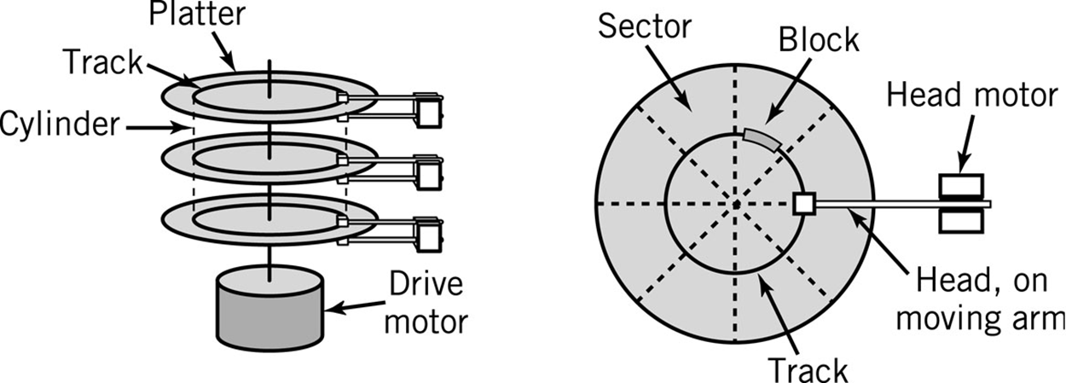
Hard Disk Layout

Slide 9
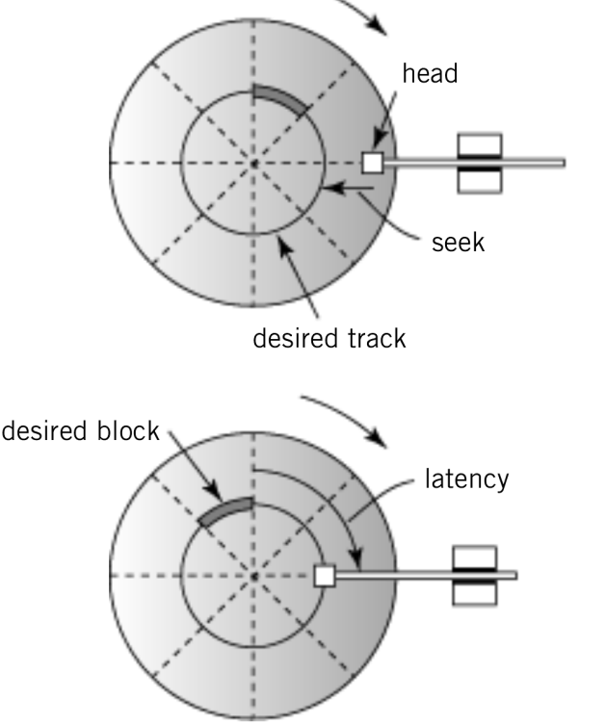

Locating a Block of Data
Average seek time:
time required to move from one track to another
Latency:
time required for disk to rotate to beginning of correct sector
Transfer time (or transfer rate):
time required to transfer a block of data to the disk controller buffer

Slide 10
Disk Access Times
Avg. Seek time
average time to move from one track to another
Avg. Latency time
average time to rotate to the beginning of the sector
Avg. Latency time = ½ * 1/rotational speed
Transfer time
1/(# of sectors * rotational speed)
Positioning time (random-access time)
time to move disk arm to desired cylinder (seek time) plus time for desired sector to rotate under the disk head (rotational latency)
Total Time to access a disk block
Avg. seek time + avg. latency time + avg. transfer time

Slide 11
Disk Addressing
Disk drives are addressed as large 1-dimensional arrays of logical blocks, where the logical block is the smallest unit of transfer.
The 1-dimensional array of logical blocks is mapped into the sectors of the disk sequentially.
Sector 0 is the first sector of the first track on the outermost cylinder.
Mapping proceeds in order through that track, then the rest of the tracks in that cylinder, and then through the rest of the cylinders from outermost to innermost.

Slide 12
Disk Management
Low-level formatting, or physical formatting — Dividing a disk into sectors that the disk controller can read and write.
To use a disk to hold files, the operating system still needs to record its own data structures on the disk.
Partition the disk into one or more groups of cylinders.
Logical formatting or “making a file system”.

Slide 13
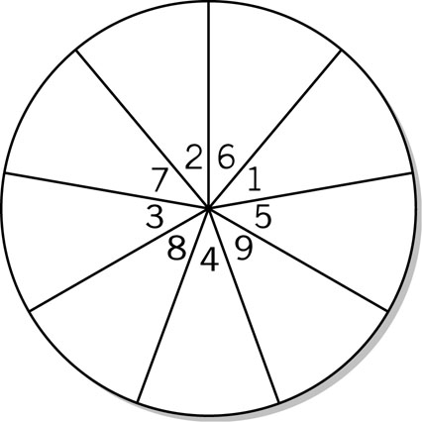
Magnetic Disks
Data Block Format
Interblock gap
Header
Data
Formatting disk
Disk Interleaving
Disk Interleaving

Slide 14
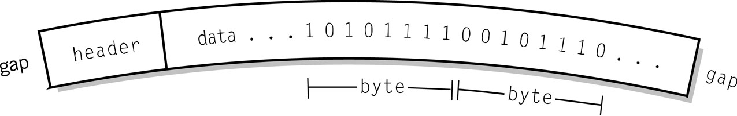
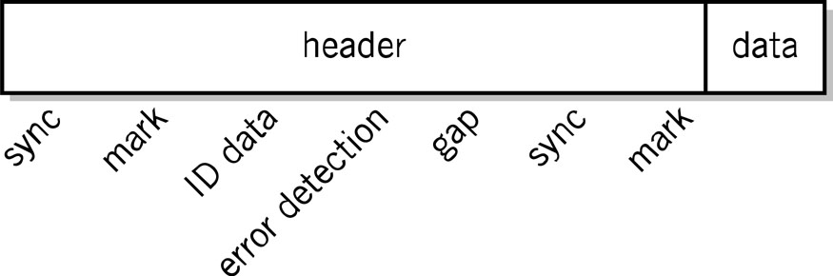
Disk Block Formats
Single Data Block
Header for Windows disk

Slide 15
Disk Arrays – RAID Structure
RAID (Redundant Array of Independent (Inexpensive) Disks) – multiple disk drives provides reliability via redundancy.
→ fault-tolerant computers
RAID is arranged into six different levels.

Slide 16
RAID (continued)
Several improvements in disk-use techniques involve the use of multiple disks working cooperatively.
Disk striping uses a group of disks as one storage unit.
when interface can handle data at a faster rate than the disk read/write process for a single disk, striping allows multiple tracks to read/write.
RAID schemes improve performance and improve the reliability of the storage system by storing redundant data.
Mirroring or shadowing keeps duplicate of each disk.
Block interleaved parity uses much less redundancy.

Slide 17
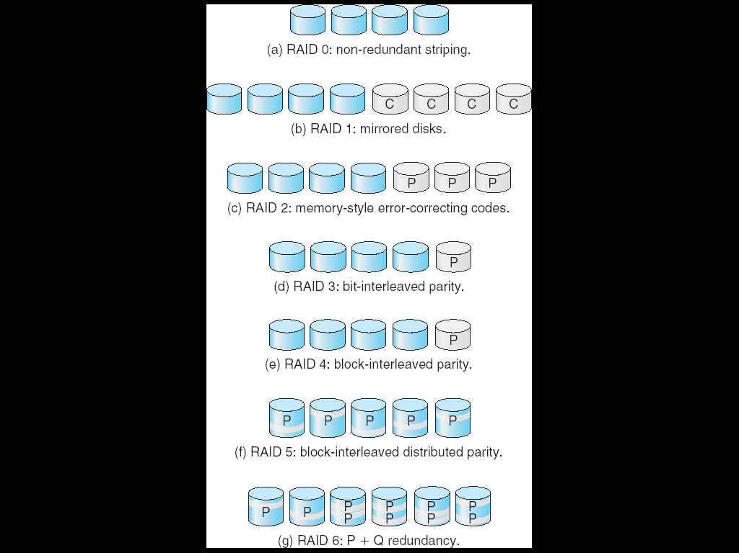
RAID (Levels)
Notes:
RAID 0 – striping yes (non-redundant), mirroring no, parity no, no tolerance
RAID 1 – striping no, mirroring yes 1:1, parity no, tolerates all but one drive
RAID 2 – striping yes, mirroring no, parity yes (Hamming Code 1c + 2d),
RAID 3 – striping yes (bit), mirroring no, parity yes, tolerant single drive
RAID 4 – striping yes (block), mirroring no, parity yes, single drive fail
RAID 5 – striping yes, mirroring no, parity yes, tolerant single drive fail
RAID 6 – striping yes, mirroring no, parity yes, tolerant two drives fail

Slide 18
Alternative Disk Technologies
Removable hard drives
Disk pack – disk platters are stored in a plastic case that is removable
Another version includes the disk head and arm assembly in the case
Fixed-head disk drives
One head per track
Eliminates the seek time

Slide 19
Magnetic Tape
Offline storage
Archival purposes
Disaster recovery
Tape Cartridges
20 – 144 tracks (side by side)
Read serially (tape backs up)
Random access ~1000x slower than HDD
4mm, 8mm DAT , 19mm, LTO-2 and SDLT
Size 20Gb -200Gb
typically includes 2:1 compression
Fallen out of significant use

Slide 20
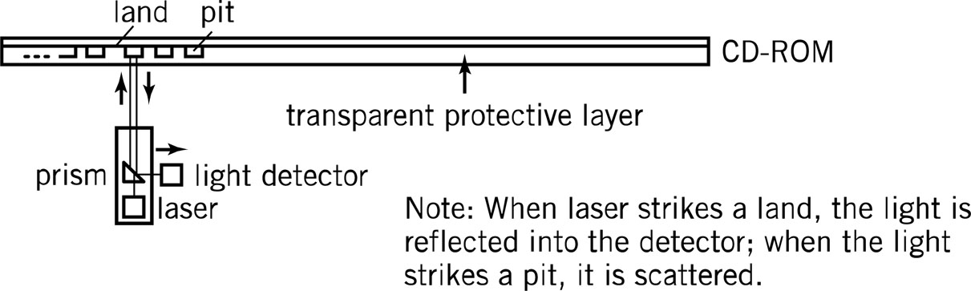
Optical Storage 1
Reflected light off a mirrored or pitted surface
CD-ROM
Spiral 3 miles long, containing 15 billion bits!
Constant Linear Velocity – all blocks are same physical length
Block – 2352 bytes, of which 2k of data (2048 bytes), 16 bytes for header (12 start, 4 id), 288 bytes for advanced error control
DVD-ROM
4.7Gb per layer, max 2 layers per side, 2 sides = 17G
Notes:
Constant Angular Acceleration (CAA) is a variant of CLV that was used on the Laserdisc format. The initial specification of CLV (as it applied to laserdisc) resulted in several playback artifacts to be present in the audio/video portion as well as compatibility problems with laserdisc players as produced by different manufacturers.
In the mid 1980s, Pioneer Electronics introduced the CAA scheme where the speed in rotation of the laserdisc was lowered in steps and eliminated most playback artifacts and compatibility problems. Since its introduction, most manufacturers of laserdiscs adopted the CAA format but still referred to their CAA-encoded product as CLV.

Slide 21
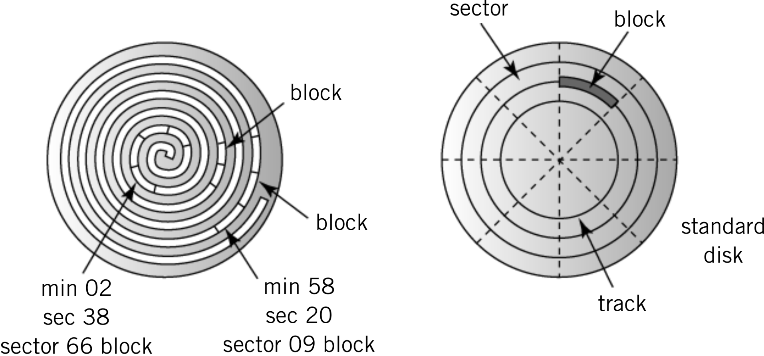
Layout CDROM vs Standard Disk
CD-ROM
Hard Disk

Slide 22
CD-ROMs

Slide 23
Types of Optical Storage 1
WORM Disks
Write-once-read-many times
Medium can be altered by using a medium-powered laser to blister the surface
Data stored in concentric tracks, sectored like a magnetic disk
Medium-powered laser blister technology also used for
CD-R, DVD-R, DVD-ROM
DVD-RAM, DVD+RAM

Slide 24
Types of Optical Storage 2
CD-RW discs contain a phase-change alloy recording layer composed of a phase change material:
An infra-red laser beam is used to selectively heat and melt, at 400 degrees (Celsius), the crystallized recording layer into an amorphous state or to anneal it at a lower temperature back to its crystalline state.
The different reflectance of the resulting areas make them appear like the pits and lands of a prerecorded CD.

Slide 25
Flash Memory
Flash memory is an electronic non-volatile computer storage medium that can be electrically erased and reprogrammed ( a variant EEPROM, coming in two types named after NAND and NOR logic gates, with NAND type allowing block read/writes, and NOR type allowing word read/writes). Capacity: Mb to many Gb
Limitations of both types include block erasure (if any part of a block is written, entire block must be wiped), memory wear (finite number of program/erase cycles), and in NAND types (read disturb where repeated reads (100,000s) can cause nearby blocks to become programmed)
Wear levelling and preemptive erase as solutions

Slide 26
Solid State Drives
Flash memory is high-speed, durable, low energy consumption, high capacity, quiet, with no mechanical parts and mechanical latencies.
This has led to emergence of solid-state drives (essentially flash memory as replacement or supplement to standard hard disks)
Retain limitation of memory wear so need wear levelling and defragmentation avoidance
Capacities 128-512 Gb with some high-end drives up to 2 Tb, but 10x more expensive per Gb than hard disks

Slide 27
Displays
Pixel – picture element
Size: diagonal length of screen
Resolution (pixels on screen)
VGA: 480 x 640
SVGA: 600 x 800
768 x 1024
1280 x 1024
1920 x 1080 (HD)
Picture size calculation
Resolution * bits required to represent number of colors in picture
Example: 16 color image, 100 pixels by 50 pixels
4 bits (16 colors) * 100 * 50 = 20,000 bits

Slide 28
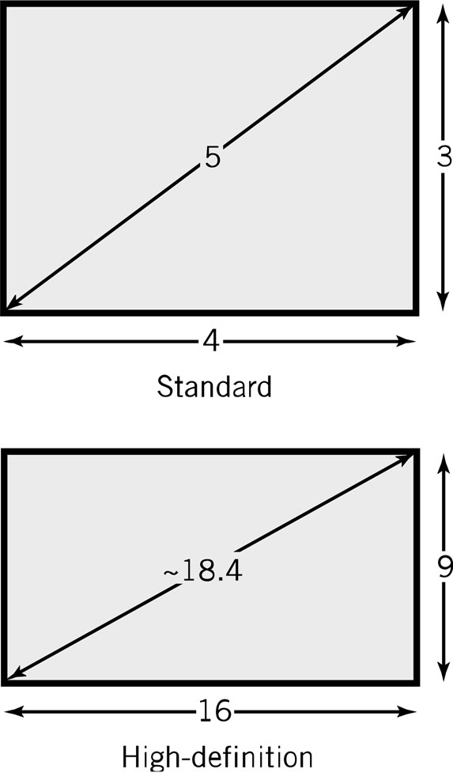
Display Screen
Screen size: measured diagonally
Resolution: minimum identifiable pixel size
Aspect ratio: x pixels to y pixels
4:3 on most PCs
16:9 on high definition and widescreen displays

Slide 29
Colour and Displays
Pixel color is determined by intensity of 3 colors – Red Green Blue or RGB
4 bits per color
16 x 16 x 16 = 4096 colors
24 bit color (True Color)
16.7 million colors
Video memory requirements are significant!

Slide 30
CRTs and Text Monitors
CRTs (similar to old TVs)
3 stripes of phosphors for each color
3 separate electron guns for each color
Strength of beam → brightness of color
Raster scan (30x per second, Interlaced vs. non-interlaced (progressive scan) )
Text monitors (e.g. simple POS systems)
24 lines x 80 chars
A character is the smallest unit on a screen
Very little memory required
Fast for remote transmissions

Slide 31
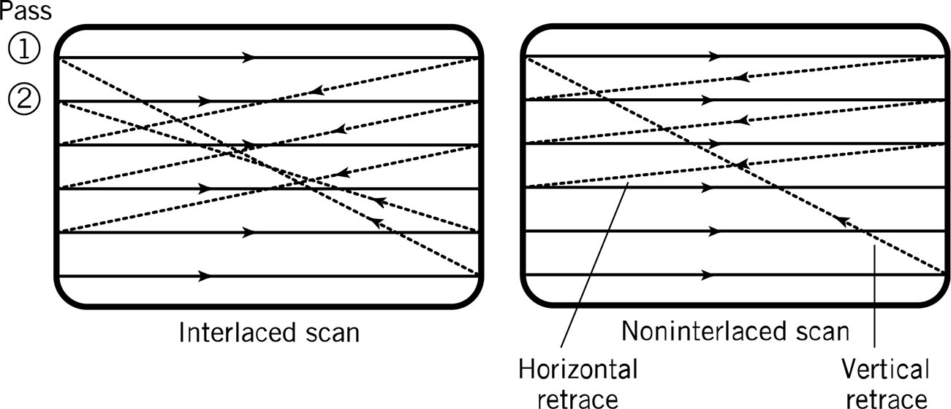
Interlaced vs Noninterlaced
Interlaced video is a technique of doubling the perceived frame rate introduced with the signal without consuming additional bandwith. With progressive scan or noninterlaced, an image is captured, transmitted, and displayed in a path similar to text on a page: line by line, from top to bottom.

Slide 32
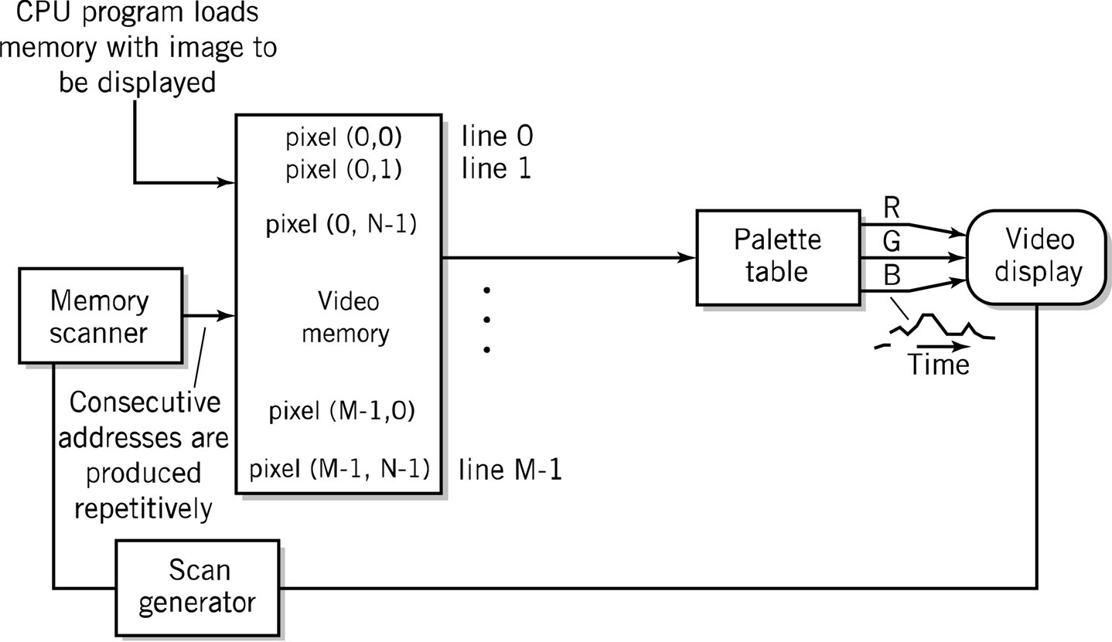
Diagram of Raster Screen Generation Process

Slide 33
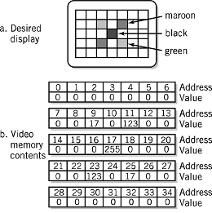
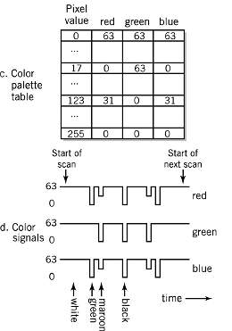
Display Example

Slide 34
LCD – Flat Screen
Fluorescent light panel
3 color cells per pixel
Operation
1st filter polarizes light in a specific direction
Electric charge rotates molecules in liquid crystal cells proportional to the strength of colors
Color filters only let through red, green, and blue light
Final filter lets through the brightness of light proportional to the polarization twist

Slide 35
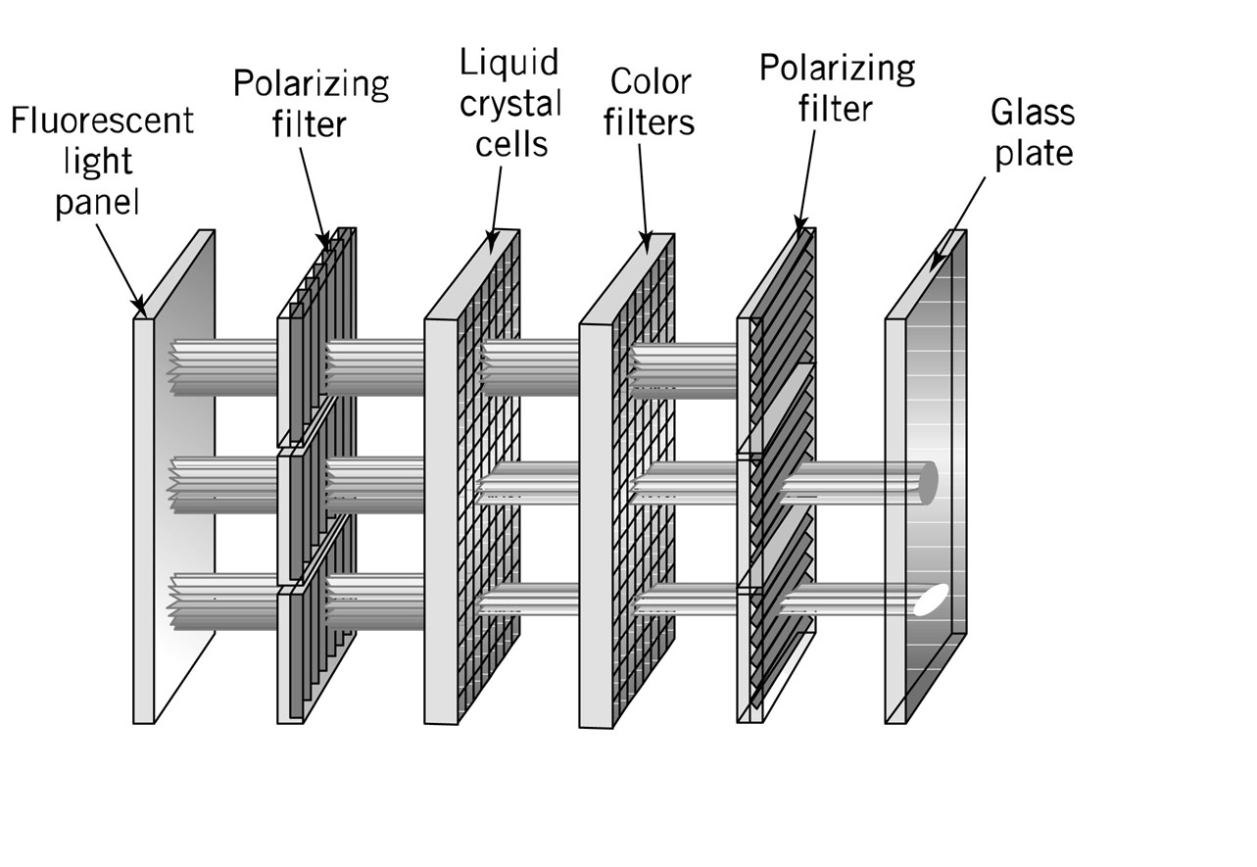
LCD Operation

Slide 36
LCDs (continued)
Active matrix
One transistor per cell
More expensive
Brighter picture
Passive matrix
One transistor per row or column
Each cell is lit in succession
Display is dimmer since pixels are lit less frequently

Slide 37
Printers
Dots vs. pixels
300-2400 dpi vs. 70-100 pixels per inch
Dots are on or off, pixels have intensities
Types
Typewriter / Daisy wheels – obsolete
Dot matrix – usually 24 pins, impact printing, esp. for multi-copy printing (line printers), also obsolete
Inkjet – squirts heated droplets of coloured ink
Laser – B/W & colour
Thermal wax transfer
Dye Sublimation

Slide 38
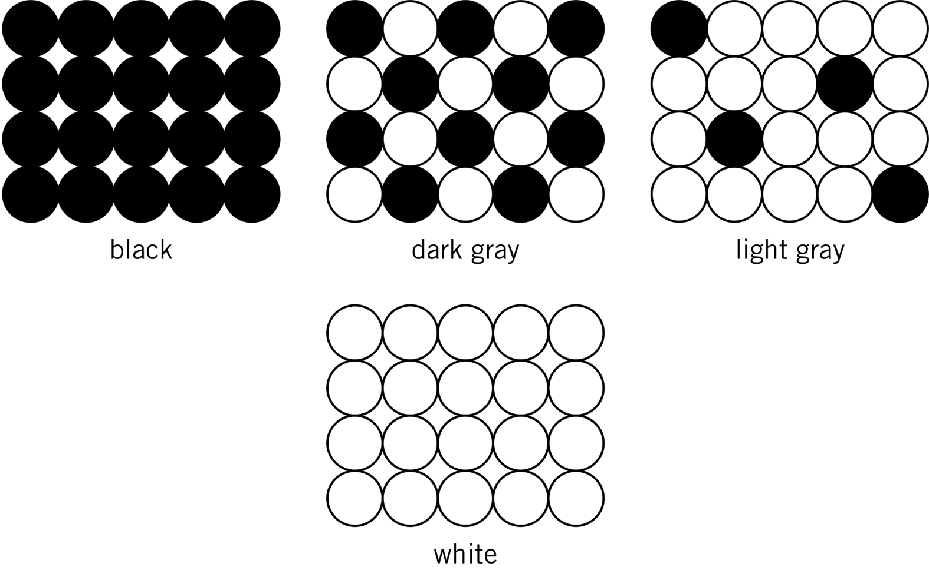
Creating a Gray Scale

Slide 39
Laser Printer Operation 1
Dots of laser light are beamed onto a drum
Drum becomes electrically charged
Drum passes through toner which then sticks to the electrically charged places
Electrically charged paper is fed toward the drum
Toner is transferred from the drum to the paper
The fusing system heats and melts the toner onto the paper
A corona wire resets the electrical charge on the drum

Slide 40
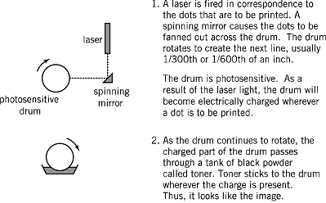
Laser Printer Operation 2

Slide 41
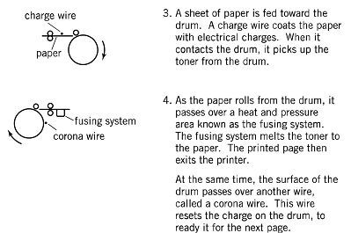
Laser Printer Operation 3

Slide 42
Touchscreen Devices 1
A resistive touchscreen panel comprises several layers, especially two thin, transparent electrically-resistive layers separated by a thin space.
Top touched screen has a coating on the underside surface and beneath it is a similar resistive layer on top of its substrate. One layer has conductive connections along its sides, the other along top and bottom. A voltage is applied to one layer, and sensed by the other.
When a fingertip or stylus tip presses down onto the outer surface, the two layers touch to become connected at that point, leading to it behaving as a pair of voltage dividers, one axis at a time. Pressures position on screen can then be read.
Notes:
Resistive touch is used in restaurants, factories and hospitals due to its high resistance to liquids and contaminants. A major benefit of resistive touch technology is its low cost. Additionally, as only sufficient pressure is necessary for the touch to be sensed, they may be used with gloves on, or by using anything rigid as a finger/stylus substitute. Disadvantages include the need to press down, and a risk of damage by sharp objects. Resistive touchscreens also suffer from poorer contrast, due to having additional reflections from the extra layer of material placed over the screen

Slide 43
Touchscreen Devices 2
A capacitive touchscreen panel consists of an insulator such as glass, coated with a transparent conductor.
Touching the surface with a finger results in a distortion of the screen's electrostatic field, measurable as a change in capacitance. Different technologies may be used to determine the location of the touch. The location is then sent to the controller for processing.
Cannot use a capacitive touchscreen through most types of electrically insulating material, such as gloves (so tablets and smartphones difficult to use in cold weather).
Solutions include a special capacitive stylus, or a special-application glove with conducting thread leading from outside to fingertip

Slide 44
Other Computer Peripherals
Scanners
Flatbed, sheet-fed, hand-held
Light is reflected off the sheet of paper onto strip of detectors
User Input Devices
Keyboard, mouse, light pens, graphics tablets
Communication Devices
Telephone modems
Network devices

